Slide 1
Measurement & Scales
Module 2.2

Slide 2



This Module Discusses…
Measurement Scales
Goodness of Measures
Measurement of Attitudes

Slide 3
Measurement
Evaluating constructs by assigning values to its various attributes.

Slide 4
Measuring Constructs
  Measurement in research depends on the type of construct under consideration.
  Empirical Construct: is directly observable and lends itself to objective and precise measurement.
  Hypothetical Construct: is an unclear phenomenon that does not lend itself to accurate measurement because of its abstract and subjective nature.

Slide 5
Scales
Tools for Measuring Constructs

Slide 6
Measurement Scales
a device providing a range of values which enables the measurement of characteristics exhibited in observing a concept.
Types of measurement scales:
  Nominal
  Ordinal
  Interval
  Ratio

Slide 7
1. Nominal Scale
A measurement scale that assigns subjects into specific categories based on a particular measurement criterion.
These are scales ‘in names only’. Numbers used are simply to represent categories, and carry no numerical value.
What is your gender?
 | M – Male
 | F – Female
What is your hair color?
 | 1 – Brown
 | 2 – Black
 | 3 – Blonde
 | 4 – Gray
 | 5 – Other

Slide 8
2. Ordinal Scale
A scale that arranges objects or alternatives according to their magnitude (size).
It is clear that Good is better than Average, but not clear by how much.
Rank the quality of service at each of our branch offices:
Abu Dhabi | Poor | Average | Good
Dubai | Poor | Average | Good
Sharjah | Poor | Average | Good

Slide 9
3. Interval Scale
A scale that not only arranges objects or alternatives according to their magnitudes but also distinguishes this ordered arrangement in units of equal intervals.
This scale not only indicates order, it also measures order.
 | Strongly Disagree | Disagree | Neutral | Agree | Strongly Agree
I enjoy shopping. | 1 | 2 | 3 | 4 | 5

Slide 10
4. Ratio Scale
A scale having actual, rather than relative, quantities and possessing an absolute zero.
Absolute zero implies that absence of a given attribute can be reported on this scale.
The responses to these questions could range from 0 to any reasonable number.
How many other organizations did you work for before joining this firm?
How many years of education have your completed?

Slide 11
Statistical Analysis of Scales
The type of scale that is utilized in business research determines the form of the statistical analysis that can be applied.
Scale | Numerical Operation | Descriptive Statistics
Nominal | Counting | Frequency & percentages
Ordinal | Rank ordering | Median, ranges, percentile
Interval | Arithmetic operations on intervals | Mean, standard deviation
Ratio | Arithmetic operations on actual quantities | Geometric mean, coefficient of variation

Slide 12
Goodness of Measures
Using Interviews & Questionnaires

Slide 13
Goodness of Measures
A test of quality that ensures that the instrument we use to measure a particular construct is in fact
  Measuring the variable accurately, and
  Targeting precisely the variable that we intend to measure.
The use of good measurement instruments confirms the accuracy of the results, which in turn, enhances the scientific quality of the research.

Slide 14
Reliability
The degree to which measures are free from error (bias) and therefore yield consistent results.
Goodness of Measures
Validity
The ability of a scale or instrument to measure what it is intended to measure.
Goodness of Measures

Slide 15
Goodness of Measures
Reliability tests how consistently an instrument measures whatever concept its is measuring.
Validity tests how well an instrument measures the particular concept it is intended to measure.
Together, reliability and validity of the measure attest to the scientific rigor that has gone into the research study.

Slide 16
Stability
Reliability
Goodness of Measures
Consistency
Validity
Goodness of Measures

Slide 17
Reliability
Stability or repeatability of a measure indicates that when a scale is administered multiple times, it yields similar results.
It can be assessed using:
  Test–Retest Reliability: The reliability coefﬁcient obtained with the repetition of the same measure on a second occasion.
  Parallel-Form Reliability: A high correlation between responses on two comparable sets of measures tapping the same construct.

Slide 18


Test–Retest Reliability (Example)
=
John
John
Survey A
Survey A
Test 1 (Sunday)
Test 2 (Wednesday)

Slide 19
Parallel-Form Reliability (Example)
=
John
John
Survey A
Survey M

Slide 20
Reliability
Internal Consistency of a measure assesses the similarity / homogeneity between the items used to measures the given construct.
It can be assessed using:
  Inter-Item Reliability: reflects consistency when participant responses to all items measuring a single construct are similar.
  Split-Half Reliability: Reflects consistency by establishing correlations between two halves of an instrument.

Slide 21
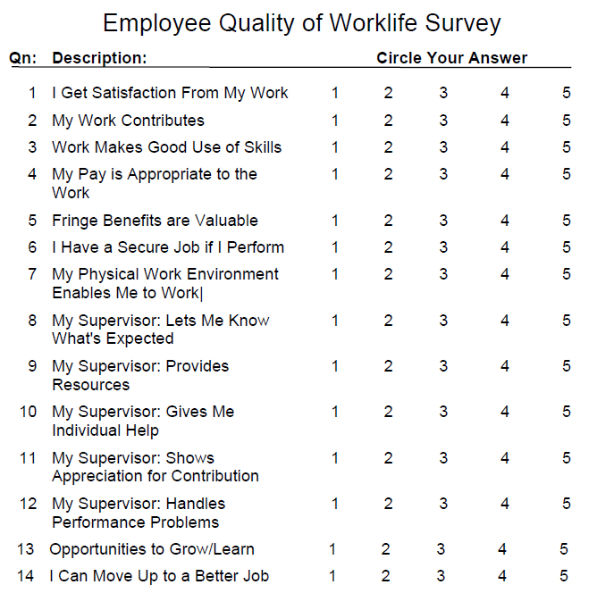
Inter-Item Reliability (Example)
Inter-Item Reliability
All 14 items measuring the construct (Quality of Work Life) should get similar responses from a participant.

Slide 22
Split-Half Reliability (Example)
Split-Half Reliability
If the instrument is divided into two halves, the results of the first half should have a strong correlation with the other half.

Slide 23
Test-Retest Reliability
Stability
Reliability
Parallel Form Reliability
Inter-Item Reliability
Goodness of Measures
Consistency
Split-Half Reliability
Validity
Content Validity
Criterion Validity
Construct Validity
Goodness of Measures

Slide 24
Validity
Content validity ensures that the measure includes an adequate and representative set of items that tap the concept.
It is commonly assessed using:
  Face Validity: an index established through professional agreement which indicates that the items that are intended to measure a concept, do on the face of it look like they measure the concept.

Slide 25
Content Validity (Example)
Face Validity
All 14 items appear to be logically related to the construct of Quality of Work Life, and seem to cover all its dimensions completely.

Slide 26
Validity
Criterion validity is the ability of a measure to correlate with other measures of the same construct.
It is measured in terms of:
  Concurrent Validity: the ability of a scale to distinguish between groups that it should theoretically be able to distinguish between.
  Predictive Validity: the ability of a scale to predict something it should theoretically be able to predict.

Slide 27


Concurrent Validity (Example)
  Sarah loves her job
  John hates his job
  A questionnaire on job satisfaction with Concurrent Validity would be able to differentiate between these employees.
  If both individuals have the same score on the job satisfaction scale, then the test would not be a valid measure of job satisfaction.

Slide 28


Predictive Validity (Example)
  Ahmed is a high achiever at work
  Ali is usually clueless about his work
  An aptitude test taken before hiring these employees should have been able to correctly indicate their future job performance.
  If the aptitude test predicted that both employees would perform equally well, the scale did not have Predictive Validity.

Slide 29
Validity
Construct validity testifies to how well the results obtained from the use of a scale fit the theories around which the scale is designed.
It is measured in terms of:
  Convergent Validity: is established when the scores obtained with two different instruments measuring the same concept are highly correlated.
  Discriminant Validity: is established when, based on theory, two variables are predicted to be uncorrelated, and the scores obtained by measuring them are empirically found to be so.

Slide 30
Convergent Validity (Example)
Consider these two separate measures on Job Satisfaction
Survey A has convergent validity if the scores obtained using it have a high correlation with the scores obtained using the standard scale.
Job Satisfaction Survey (New) | SD SA
Overall, I am satisfied at my firm | 1 | 2 | 3 | 4 | 5
I find my work challenging | 1 | 2 | 3 | 4 | 5
I like the kind of work I do | 1 | 2 | 3 | 4 | 5
My working conditions are good | 1 | 2 | 3 | 4 | 5
Job Satisfaction (Standard) | SD SA
I feel satisfied at this firm. | 1 | 2 | 3 | 4 | 5
I have on good terms with peers. | 1 | 2 | 3 | 4 | 5
My job is rewarding. | 1 | 2 | 3 | 4 | 5
I enjoy coming to work. | 1 | 2 | 3 | 4 | 5
New Measure of Job Satisfaction
Previously Validated Measure of Job Satisfaction

Slide 31
Discriminant Validity (Example)
Theoretically, the constructs job satisfaction and achievement motivation are unrelated.
The job satisfaction survey would have discriminant validity if its results showed weak correlation with the results of the achievement motivation survey.
Job Satisfaction Survey | SD SA
Overall, I am satisfied at my firm | 1 | 2 | 3 | 4 | 5
I find my work challenging | 1 | 2 | 3 | 4 | 5
I like the kind of work I do | 1 | 2 | 3 | 4 | 5
My working conditions are good | 1 | 2 | 3 | 4 | 5
Achievement Motivation Survey | SD SA
I consider myself as hardworking. | 1 | 2 | 3 | 4 | 5
I enjoy spending my time at work. | 1 | 2 | 3 | 4 | 5
I like to be the best at what I do. | 1 | 2 | 3 | 4 | 5
I like to deal with difficult situations | 1 | 2 | 3 | 4 | 5

Slide 32
Types of Validity
Types | What is Measured | Method
Content | Does the measure adequately measure the concept? | Expert Advice
Criterion | Does the measure differentiate in a manner that helps to predict a criterion variable? | Correlation
Concurrent | Does the measure differentiate in a manner that helps to predict a criterion variable currently.
Predictive | Does the measure differentiate individuals in a manner as to help predict a future criterion?
Construct | Does the instrument tap the concept as theorized? | Correlation
Convergent | Do two instruments measuring the concept correlate highly?
Discriminant | Does the measure have a low correlation with a variable that is supposed to be unrelated to this variable?

Slide 33
Test-Retest Reliability
Stability
Reliability
Parallel Form Reliability
Inter-Item Reliability
Goodness of Measures
Consistency
Split-Half Reliability
Validity
Content Validity
Criterion Validity
Construct Validity
Goodness of Measures
Face
Concurrent
Predictive
Convergent
Discriminant

Slide 34
Attitude Measurement
Using Interviews & Questionnaires

Slide 35
Attitude
A settled way of thinking or feeling about something.

Slide 36
Attitude Measurement
Attitude is a hypothetical construct, i.e. a variable that is not directly observable, but is measurable by indirect means such as verbal expression or overt behavior.
It is defined in terms of its three components
  Affective
  Cognitive
  Behavioral

Slide 37
Components of Attitudes
Affective Component
  Feelings / emotions about an object.
    Example: “I love my the organization I work for”.
Cognitive Component
  Knowledge and beliefs about an object.
    Example: “I think my organization works for the betterment of people”.
Behavioral Component
  Tendency to behave in a particular way towards and object.
    Example: “I recommend my firm to friends”.

Slide 38
Selecting a Measurement Scale
Affective Component
  Feelings / emotions about an object.
    Example: “I love my the organization I work for”.
Cognitive Component
  Knowledge and beliefs about an object.
    Example: “I think my organization works for the betterment of people”.
Behavioral Component
  Tendency to behave in a particular way towards and object.
    Example: “I recommend my firm to friends”.

Slide 39
Techniques for Measuring Attitudes
Ranking
  Requiring the respondent to rank order objects in overall performance on the basis of a characteristic.
Rating
  Asking the respondent to estimate the magnitude of a characteristic, or quality, that an object possesses by indicating on a scale where he or she would rate an object.
Sorting
  Presenting the respondent with several concepts and requiring the respondent to arrange or otherwise classify the concepts.
Choice
  Asking a respondent to choose one alternative from among several alternatives; it is assumed that the chosen alternative is preferred over the others.

Slide 40
Ranking
An ordinal scale that asks respondents to rank order (from most preferred to least preferred) a set of objects or attributes.
Rank the following service features in order of your preference (1 being most preferred).
Speed of Delivery
Taste of Food
Price of Meals
Variety of Cuisines
24 hour Customer Service
The Internet is superior to traditional libraries for comprehensive searches.
    Strongly Disagree
    Disagree
    Neither Agree nor Disagree
    Agree
    Strongly Agree

Slide 41
Rating
An interval or ratio scale that requires participants to score an object without making a direct comparison to another object or attitude.
The Internet is superior to traditional libraries for comprehensive searches.
    Strongly Disagree
    Disagree
    Neither Agree nor Disagree
    Agree
    Strongly Agree

Slide 42
Commonly Used Rating Scales
Measure | Subject Must | Advantages | Disadvantages
Category Scale | Indicate a response category | Flexible, easy to respond to | Ambiguous
I plan to purchase an HP laptop in the next 12 months.
    Yes
    Maybe
    No

Slide 43
Commonly Used Rating Scales
Measure | Subject Must | Advantages | Disadvantages
Likert Scale | Evaluate statements on a scale of agreement | Easiest scale to construct | Hard to judge what a single score means
The Internet is superior to traditional libraries for comprehensive searches.
    Strongly Disagree
    Disagree
    Neither Agree nor Disagree
    Agree
    Strongly Agree

Slide 44
Commonly Used Rating Scales
Measure | Subject Must | Advantages | Disadvantages
Semantic Differential Scale | Choose points between bipolar adjectives on relevant dimensions | Easy to construct; norms exist for comparison, such as profile analysis | Bipolar adjectives must be found; data may be ordinal, not interval
Indicate the nature of managerial work you prefer to do.
Short term planning | ☐ | ☐ | ☐ | ☐ | ☐ | Long term planning
Reactive thinking | ☐ | ☐ | ☐ | ☐ | ☐ | Reflective thinking
Concrete work | ☐ | ☐ | ☐ | ☐ | ☐ | Conceptual work
Ongoing, routines | ☐ | ☐ | ☐ | ☐ | ☐ | Creative work

Slide 45
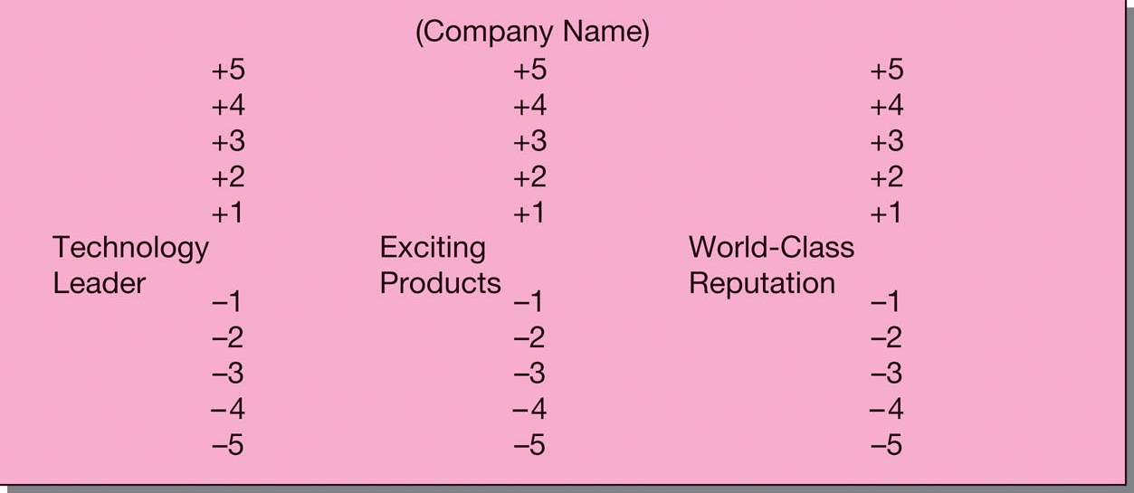
Commonly Used Rating Scales
Measure | Subject Must | Advantages | Disadvantages
Stapel Scale | Choose points on a scale with a single adjective in the center | Easier to construct than semantic differential, easy to administer | Endpoints are numerical, not verbal, labels

Slide 46
Commonly Used Rating Scales
Measure | Subject Must | Advantages | Disadvantages
Constant-sum scale | Divide a constant sum among response alternatives | Approximates an interval measure | Difficult for respondents with low education levels
In choosing a hand cream, indicate the importance of the following by allotting points for each to total 100 in all:
Fragrance
Color
Shape
Size

Slide 47
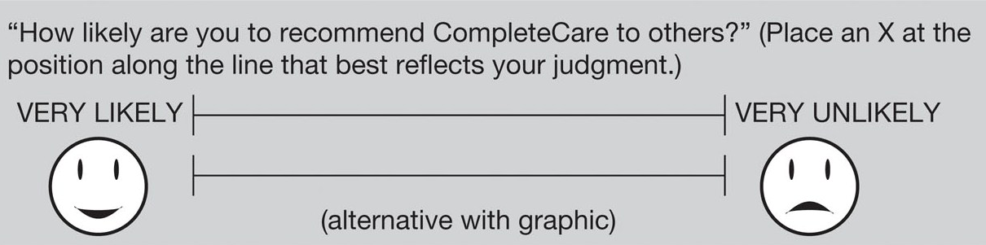
Commonly Used Rating Scales
Measure | Subject Must | Advantages | Disadvantages
Graphic scale | Choose a point on a continuum | Visual impact, unlimited scale points | No standard answers

Slide 48
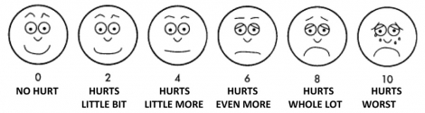
Commonly Used Rating Scales
Measure | Subject Must | Advantages | Disadvantages
Graphic scale with picture response | Choose a visual picture | Visual impact, easy for poor readers | Hard to attach a verbal explanation to a response
How would you rate your pain?

Slide 49
Commonly Used Rating Scales
Measure | Subject Must | Advantages | Disadvantages
Category Scale | Indicate a response category | Flexible, easy to respond to | Ambiguous
Likert Scale | Evaluate statements on a scale of agreement | Easiest scale to construct | Hard to judge what a single score means
Semantic Differential Scale | Choose points between bipolar adjectives on relevant dimensions | Easy to construct; norms exist for comparison, such as profile analysis | Bipolar adjectives must be found; data may be ordinal, not interval
Stapel Scale | Choose points on a scale with a single adjective in the center | Easier to construct than semantic differential, easy to administer | Endpoints are numerical, not verbal, labels
Constant-sum scale | Divide a constant sum among response alternatives | Approximates an interval measure | Difficult for respondents with low education levels
Graphic scale | Choose a point on a continuum | Visual impact, unlimited scale points | No standard answers
Graphic scale with picture response | Choose a visual picture | Visual impact, easy for poor readers | Hard to attach a verbal explanation to a response

Slide 50
Sorting
A nominal scale that asks participants to place/organize certain elements of interest into groups or categories.
Categorize the following cars into one of these categories:
    BMW 7-Series
    Mercedes-Benz S-Class
    Volvo S60 - Sports
Elegant
Futuristic
Safe

Slide 51
Choice
A choice scale requires that participants choose one alternative over another.
What newspaper do you read most often for financial news?
    Khaleej Times
    Gulf News
    Zawya
    The National
    Other (specify:_________)

Slide 52
Issues In Selecting A Measurement Scale
Measurement scales are either one-dimensional or multidimensional.
With a one-dimensional scale, only one attribute of the participant or object is measured.
A multidimensional scale recognizes that an object might be better described with several dimensions than on a one-dimensional continuum.
Number of Dimensions in a Scale

Slide 53
Issues In Selecting A Measurement Scale
Balanced rating scale: equal number of categories above and below the midpoint. Example: very good—good—average—poor—very poor
  This example allows equal options to rate favorable and unfavorable responses.
Unbalanced rating scale: unequal number of favorable and unfavorable response choices. Example: poor—fair—good—very good— excellent
  This example does not allow participants who are unfavorable to express the intensity of their attitude.
Balanced or Unbalanced Scale

Slide 54
Issues In Selecting A Measurement Scale
An unforced-choice rating scale allows participants to express no opinion when they are unable to make a choice among the alternatives offered.
A forced-choice scale requires that participants select one of the offered alternatives.
Researchers often exclude “no opinion,” “undecided,” “don’t know,” “uncertain,” or “neutral” when they know that most participants have an attitude on the topic.
Force or Unforced Choice

Slide 55
Issues In Selecting A Measurement Scale
The larger the number of categories the more sensitive the scale is. However, the use of several categories makes it more difficult for respondents to answer.
The decision depends on the construct being measured.
  A 3-point scale (better than average, average, worse than average) is sufficient for a fast-food burger.
  A 5 or 7-point scale would be needed to measure complex constructs, such as employee job satisfaction.
Number of Scale Points to Use

Slide 56
Issues In Selecting A Measurement Scale
The more items on a scale, the more reliable (replicable) the measurement.
Many items reduce the chances that the attitude score is due to error or chance.
On the other hand, multiple items can focus on different aspects of the attitude (i.e., lack of homogeneity - scale no longer measures one concept, but two or more).
Number of Items to be Included in the Scale

Slide 57
Data in research can be measured using any of the four types of measurement scales: nominal, ordinal, interval, or ratio.
The type of scale that is utilized in business research determines the form of the statistical analysis that can be applied.
The quality of measurement is assessed using reliability and validity. Together they affirm that the instrument used to measure a particular construct is in fact measuring that same construct, and doing so accurately.
Attitude is a hypothetical construct that can be assessed in terms of its affective, cognitive, or behavioral component.
The four techniques used to measure attitudes include rating, ranking, sorting, and choice.
In Summary

